Slide 1
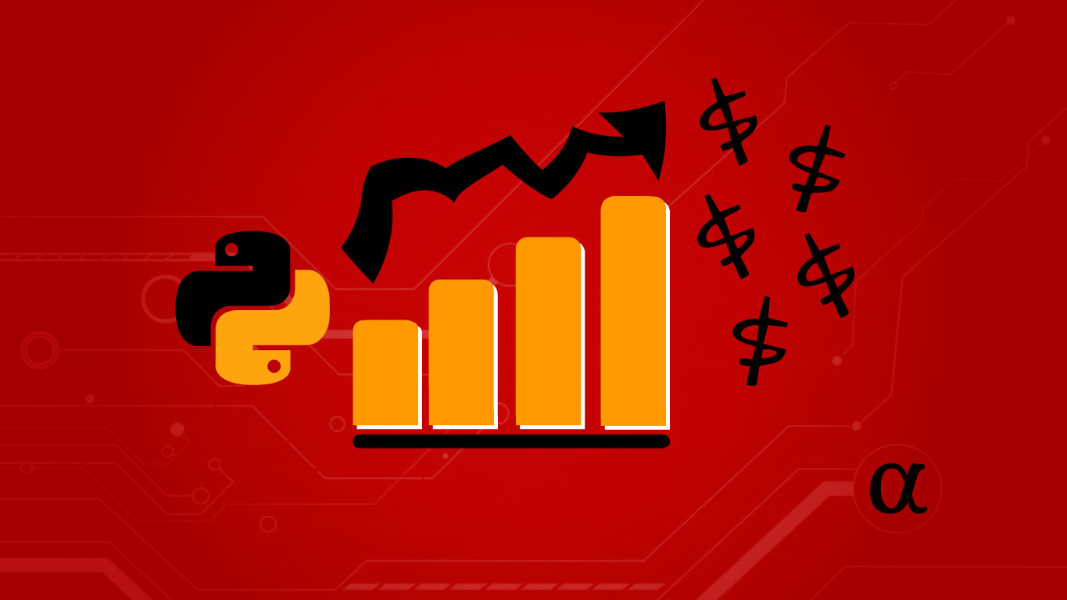
VISUALIZING AND FORECASTING STOCKS

Slide 2
PROJECT TEAM:
TEAM LEADER – SANYA RASTOGI
MEMBERS – AKSHI VISHNOI
– AYUSH PATHAK
– AYUSH JHA
PROJECT SUPERVISOR:
MR.ANKIT VERMA

Slide 3
INTRODUCTION:
A stock is the small chunk of ownership in the company. The stock price of the company reflects the net evaluation of the company and also gives a little insight into its performance.
These stocks are traded on exchanges and their prices are constantly changing due to their demand and supply in the market.
If a stock is in high demand and low in supply i.e. more people want to buy it and fewer people are willing to sell it then the price for the stock will go up and similarly if the stock is in low demand and high on supply which means people more people are ready to sell it but fewer people are willing to buy it then its prices go down.

Slide 4
The sudden increase in the demand for the stock can be due to various reasons including positive news about the company or an announcement from the company.
After a period of time when the demand for the stock vanishes its prices slowly creep down as the investor loses interest in it. These stock prices going up and down is an iterative process and repeated.
This volatility of stock makes investors nervous while investing in a company. So to understand the risk associated with it there must be a proper analysis of stock before buying it.
Developing this simple project idea using the Dash library (of Python), we can make dynamic plots of the financial data of a specific company by using the tabular data provided by yfinance (yahoo) python library. On top of it we can use a machine learning algorithm to predict the upcoming stock prices.

Slide 5
SOFTWARE REQUIREMENTS:
We will be using the Python(Jupyter Notebook) with :
Dash framework,
Various libraries such as:
yfinance is a library that allows us to fetch financial data of a company from its stock code directly.
gunicorn and lxml libraries will be used for the application's deployment i.e. to host the app on a target server.
plotly library of Python is used to generate plots of data.
numpy library is used for multi-dimensional array operations
pandas is used for creating DataFrames to efficiently manage the data.
Heroku is a platform as a service (PaaS) that enables developers to build, run, and operate applications entirely in the cloud.

Slide 6
HARDWARE REQUIREMENTS:
Hard disk – 10GB or above
RAM – 4GB
Processor – i5

Slide 7
MODULES DESCRIPTIONS:
Developing and designing web page
Retrieving data set and plotting graph
Implementing ML model to retrieve information
Testing the developed web application
Deploying the project on Heroku

Slide 8
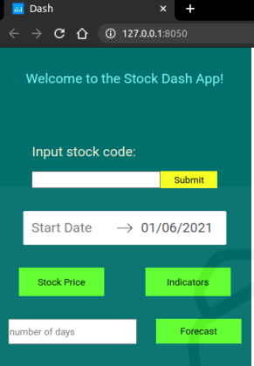
OUTPUT:
After finishing all the modules and tasks, we should have a complete project where user input - stock, code can give us the company information and relevant plots. Also, user input number of days can give us a forecast plot .

Slide 9
CONCLUSIONS:
Stock market Trading is the most sought after and so its popularity is increasing and researchers ought to find new techniques for prediction. Stock forecasting and visualizing techniques help investors and individuals to handle the stock market. For predicting the stock prices correctly the forecasting model should have great precision.
According to a recent report the number of investors investing in the stock market is increasing every year, therefore a system of visualizing and forecasting stocks is required to guide the investors to invest carefully in the stocks.

Slide 10
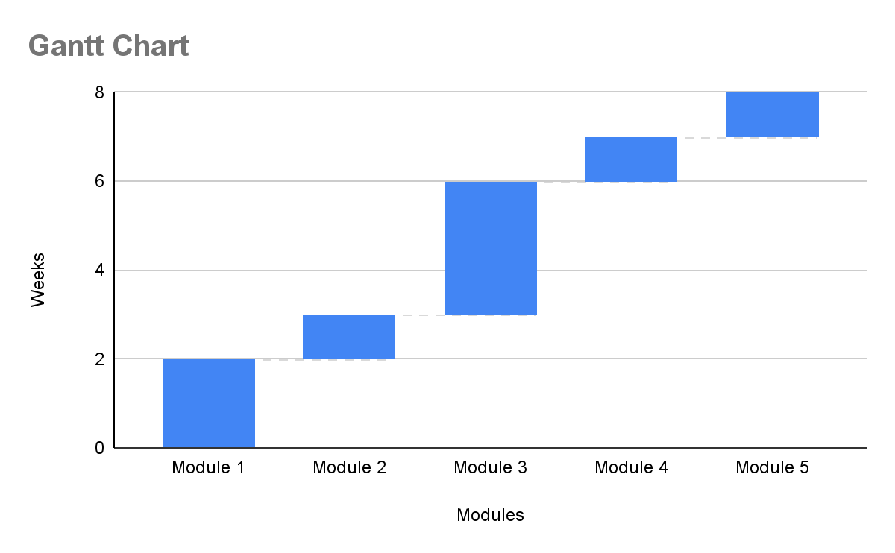
GANTT CHART:

Slide 11
THANK YOU

